Slide 1

DIGGS
Past, Present and Future
Gary Morin: Director and Co-Founder
Gary.morin@Keynetix.com

Slide 2
The problem DIGGS Solves

Slide 3
Data in USA
Data Standardization is not common within states or companies!
Each project has its own data structure
Data not delivered to DOTs
Notes:
FHWA = Federal Highways Authority
Consortium of Organizations for Strong Motion Observation Systems (COSMOS)

Slide 4
What Data is Included
Initial Phase
SI factual data
laboratory testing
insitu testing
monitoring
Additional investigation
Piling
Pile Load Testing Data

Slide 5
History of DIGGS

Slide 6
History of DIGGS
Project “Digital Interchange for Geotechnical and Geoenvironmental Specialists” started in 2004.
Pooled Study fund by FHWA with 20 DOTs as sponsors
Also included AGS, COMOS who had existing data dictionaries and formats
Notes:
FHWA = Federal Highways Authority
Consortium of Organizations for Strong Motion Observation Systems (COSMOS)

Slide 7
History of DIGGS
2009 - Version 1 released for review
Many suggestions and improvements requested
2012 - Version 2.0 released
Additional tools made available for users to create and consume the data
2014 – Project moved to Geoinstitute Technical Committee
2018 – Version 2.5 released
Specified by Ohio DOT and 2 other DOTs, backed by USGS
Notes:
Version 1 was written by Keynetix (Chris Bray)
Version 2 was written by Galdos under contract - http://www.galdosinc.com/ - they have lots of GML knowledge

Slide 8
What is in a DIGGS File?

Slide 9
What is a DIGGS file
GML compatible XML file
A combination of the COSMOS and AGS Dictionaries
Compatible with AGS 4
AGS to DIGGS converter is now available free from Keynetix.

Slide 10
Defined or Other properties
The majority of properties are defined in the schema but there will be times when you need project specific values.
These can be defined using a name and value combination in a specific object. These are often referred to as Name/Value pairs.

Slide 11
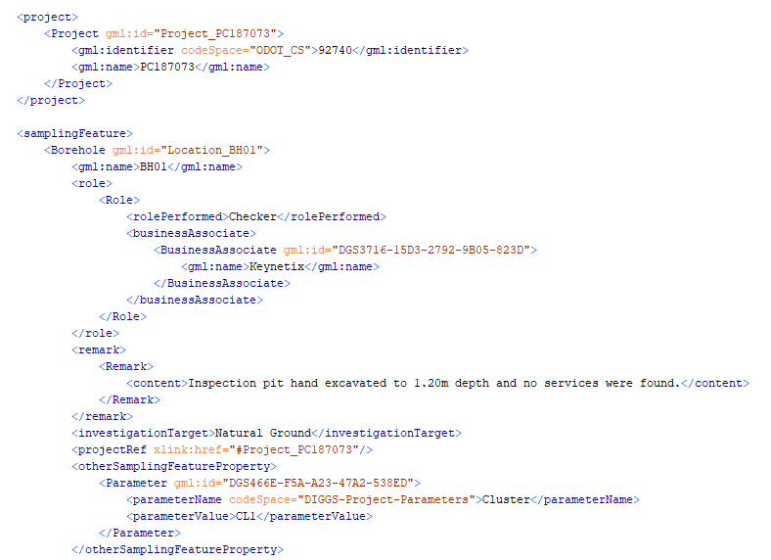
Extract from DIGGS file
Project Object
Remark Object in
Borehole Object
Reference Link to Project
Other Name/Value Properties
Notes:
All put together in an XML file

Slide 12
Where now for DIGGS?

Slide 13
Software
Programs available to extract data from gINT, AGS or HoleBASE via Keynetix
Webservices available for conversion to CSV data via Dataforensics

Slide 14
Specification
More USA DOTs are now looking to specify the delivery of data using DIGGS now there are affordable tools available to create it.

